Slide 1
New Scout and Parent Orientation
(Troop or Pack) (num)
(month) (year)

Slide 2
Agenda
Look Ahead - 5 min
New Scout Orientation - 15 min
  Introductions and Troop Organization
  Activity Overview
New Parent Orientation - 30 min
  Aims and Methods of Scouting
  Ten Essentials for New Scout Parents
  Troop Policies
  Fundraiser / Scout Camp
Paperwork - 30 min
Martin

Slide 3
Look Ahead
First New Scout Campout
  Saturday April 23-24, time TBD @ WRFD
  Gear list found on Troop Website
  Scouts camp as a patrol, assisted by youth leaders
  Parents may attend, but will camp in adult area away from scouts, parents bring own gear
First Court of Honor and Induction
  Tuesday May 24th, 7:30pm @ TBD Location
  Wear full uniform - shirts, pants, belt, socks, neckerchief (webelos), and slide (webelos)
  All new scouts and parents attend
  Finish Scout rank requirements before Induction, work with ASMs
Martin

Slide 4
Unit Organization
Who’s in charge around here?
Martin

Slide 5
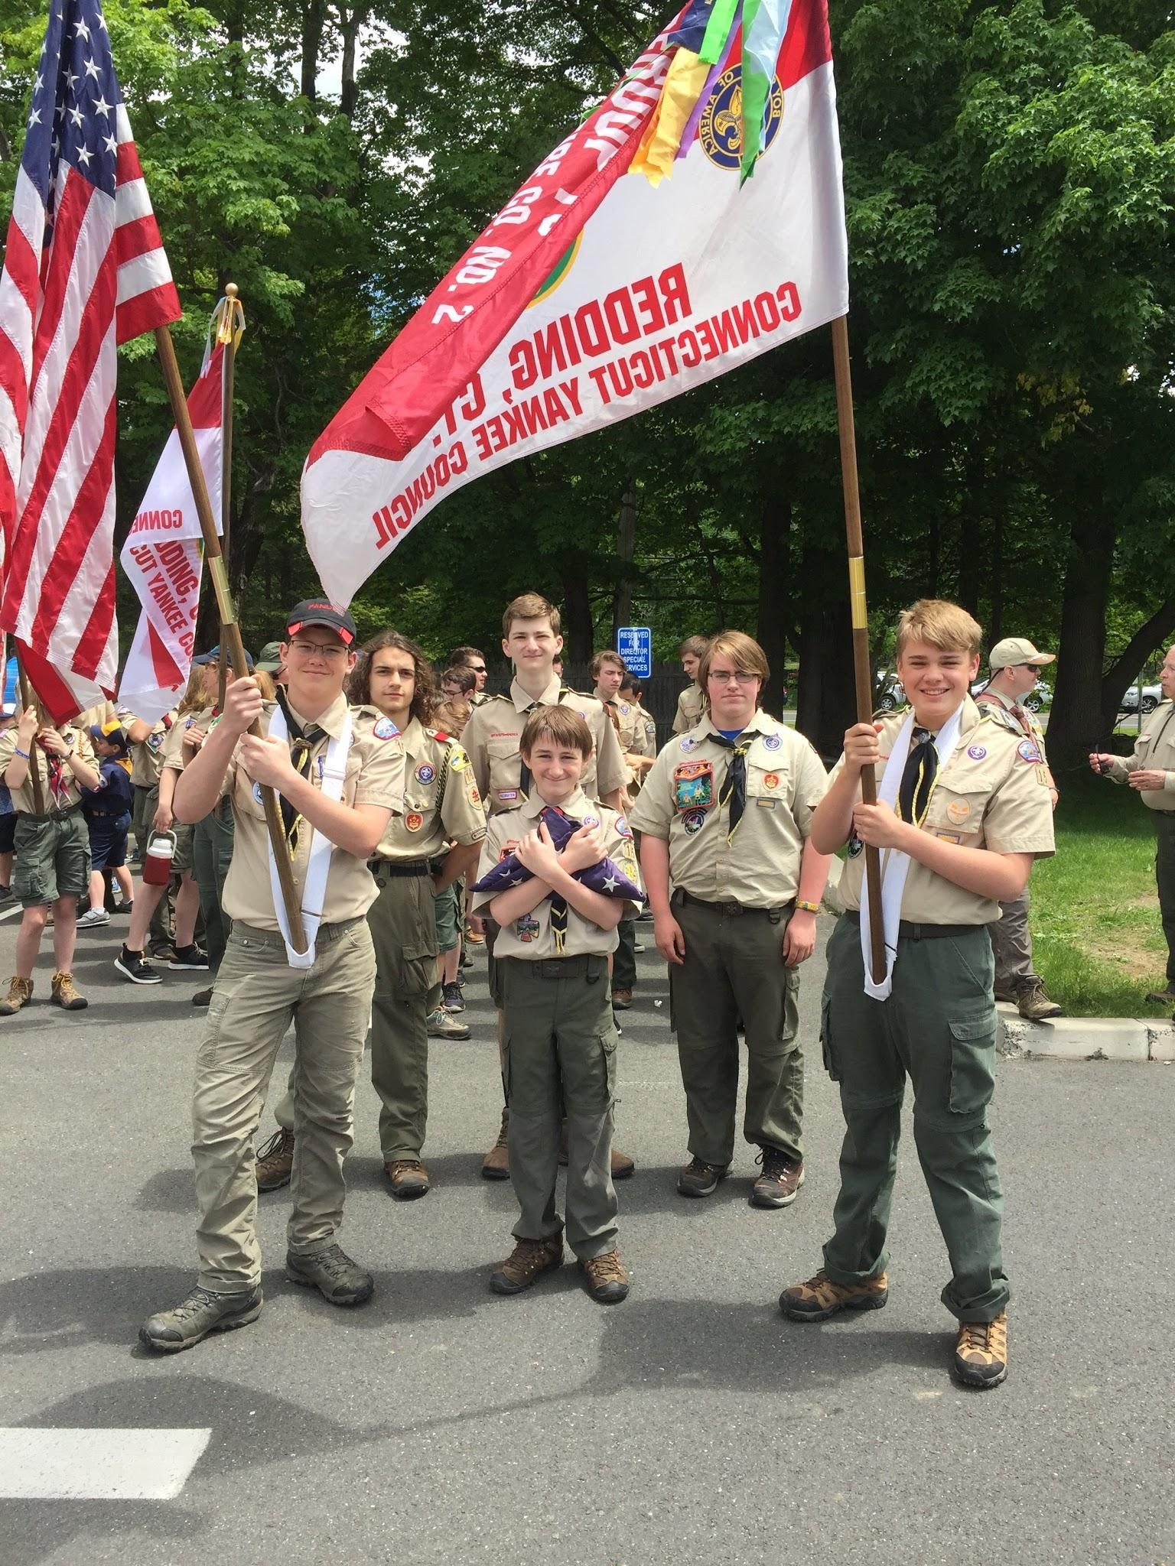
Troop Organization
Scouts BSA is SCOUT-LED
Youth lead the troop
  Youth decide what the troop does
  Youth lead the activities
  Youth teach each other
Adults provide needed support,
but are not in charge
Martin

Slide 6
Troop Leadership (Youth Leaders)
Senior Patrol Leader
  unit leader, runs the patrol leader council (PLC), presides at all activities, assigns other scouts to leadership positions
Assistant Senior Patrol Leader
  trains and directs youth leaders, fills in for SPL when absent
Patrol Leader
  plans and leads patrol activities, keeps patrol members informed, assigns tasks to patrol members, represents patrol at PLC
Troop Guide
  guides new scouts from position of experience
Martin

Slide 7
Support Staff (Adult Leaders)
Scoutmaster and Assistant Scoutmasters
  coaches and trains the youth leadership, ensures the troop follows BSA policy, and keeps everyone safe, provides two-deep leadership
Troop Committee Chair
  organizes and leads the Troop Committee (Support Staff / Adult Leaders)
Activity Chair
  organizes campouts and activities, makes reservations, sends out signups, etc.
Advancement Chair
  helps with rank advancement, organizes Boards of Review when you finish a rank, and helps SPL to plan Courts of Honor (award ceremonies)
Martin

Slide 8
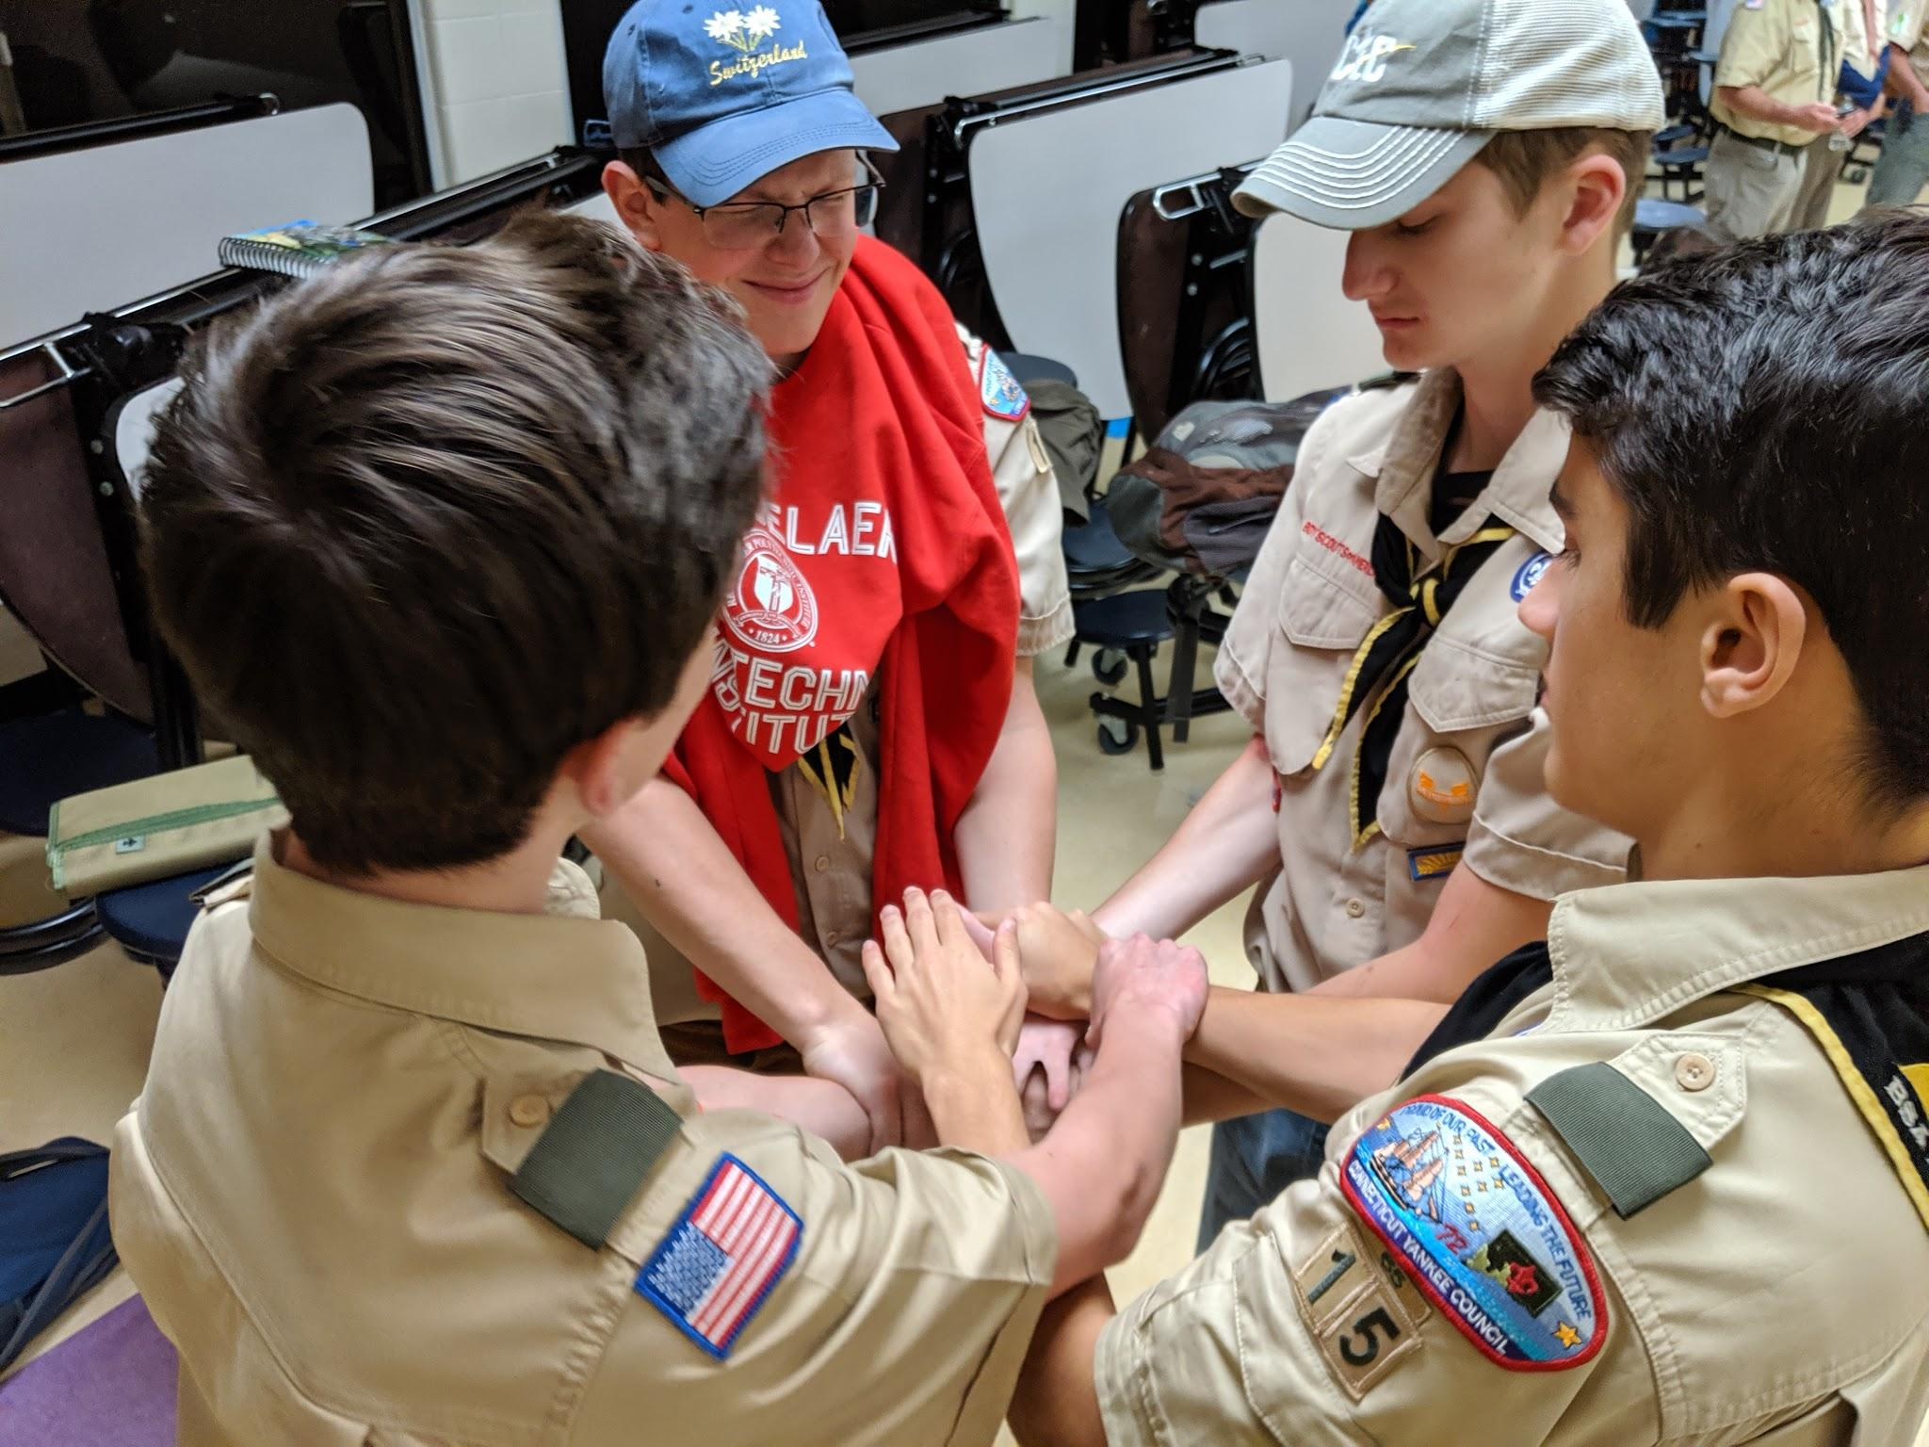
Patrol Leader Council
Scout-led
SPL, ASPLs, PLs, Scribe, Troop Guides, and Scoutmasters attend
New scouts don’t attend
One week a month will be PLC instead of a regular troop meeting
Tell your Patrol Leader your ideas!
Martin

Slide 9
What do we do in
Scouts BSA?
Job one is have fun
Martin

Slide 10
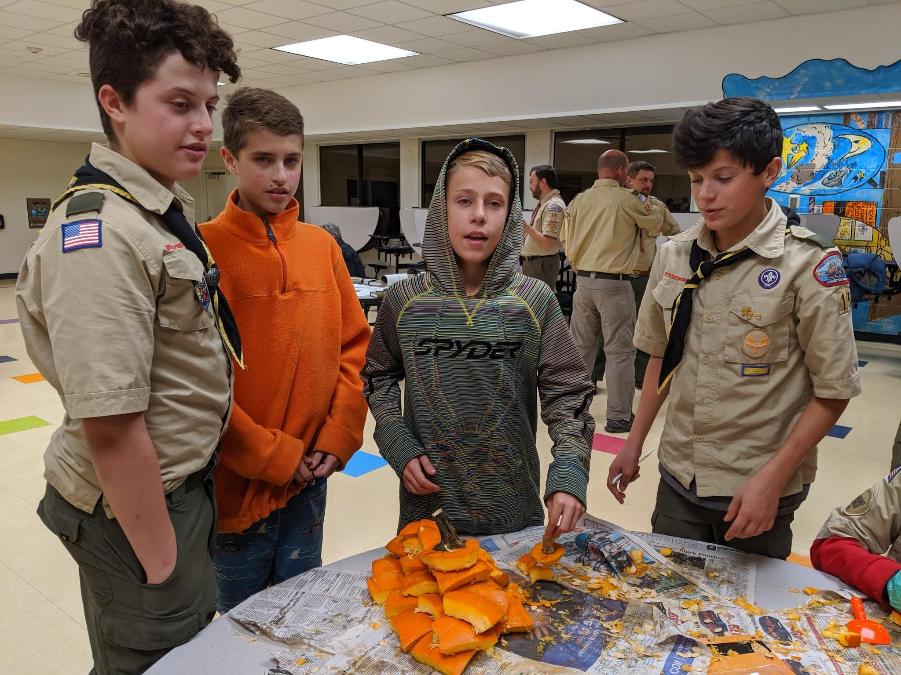
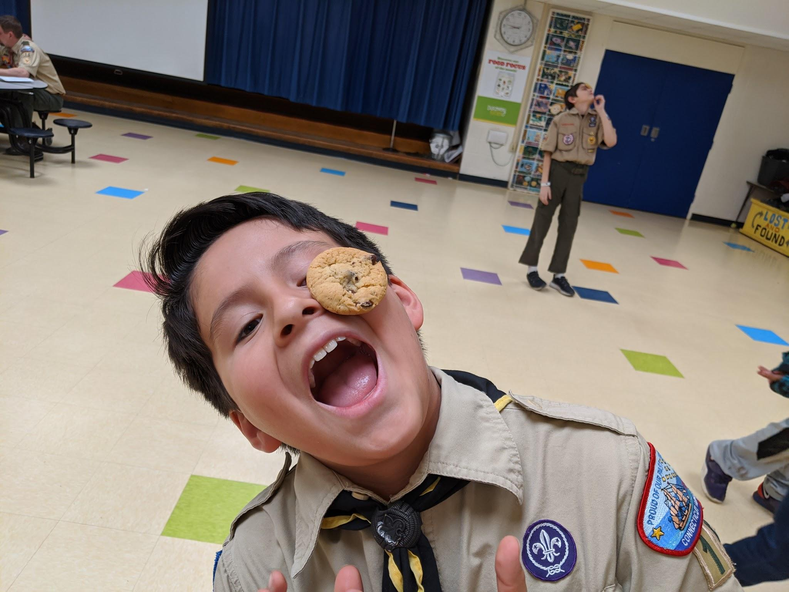
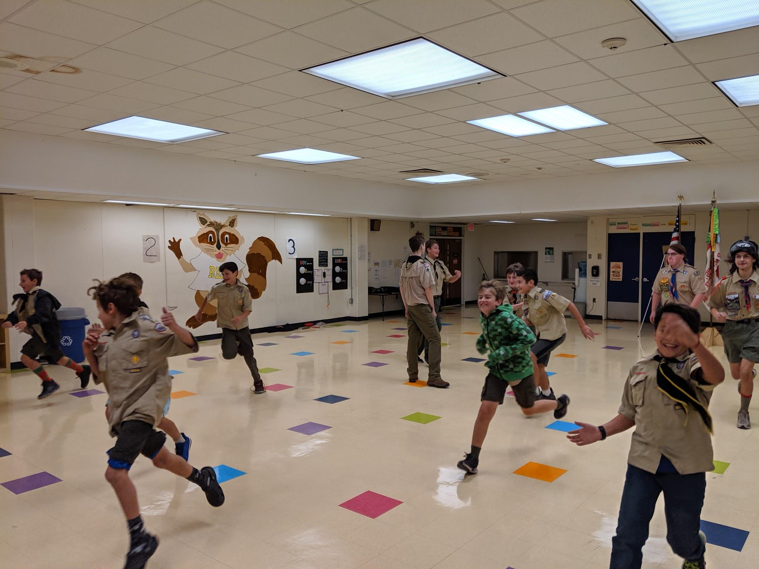
Troop Meetings
Fun! Fun! Fun!
Training
Advancement
Games
Challenges
Martin

Slide 11
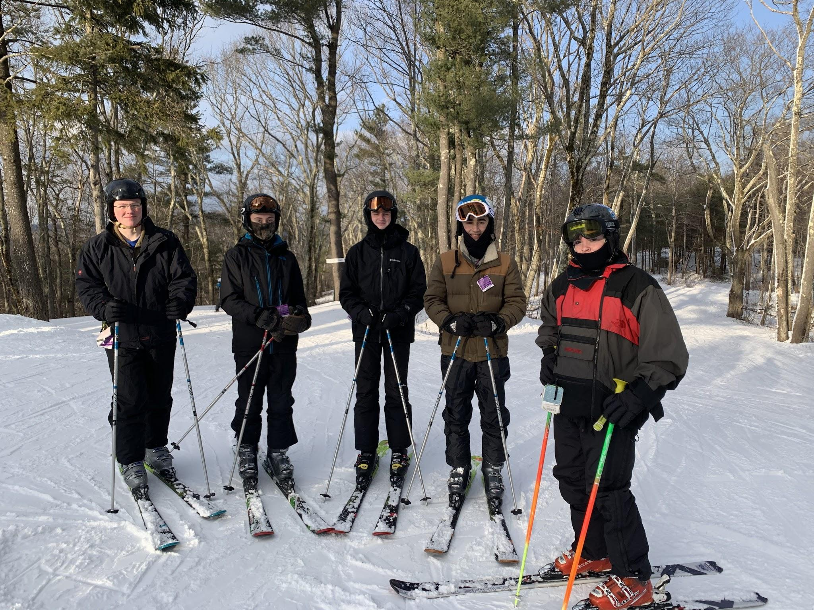
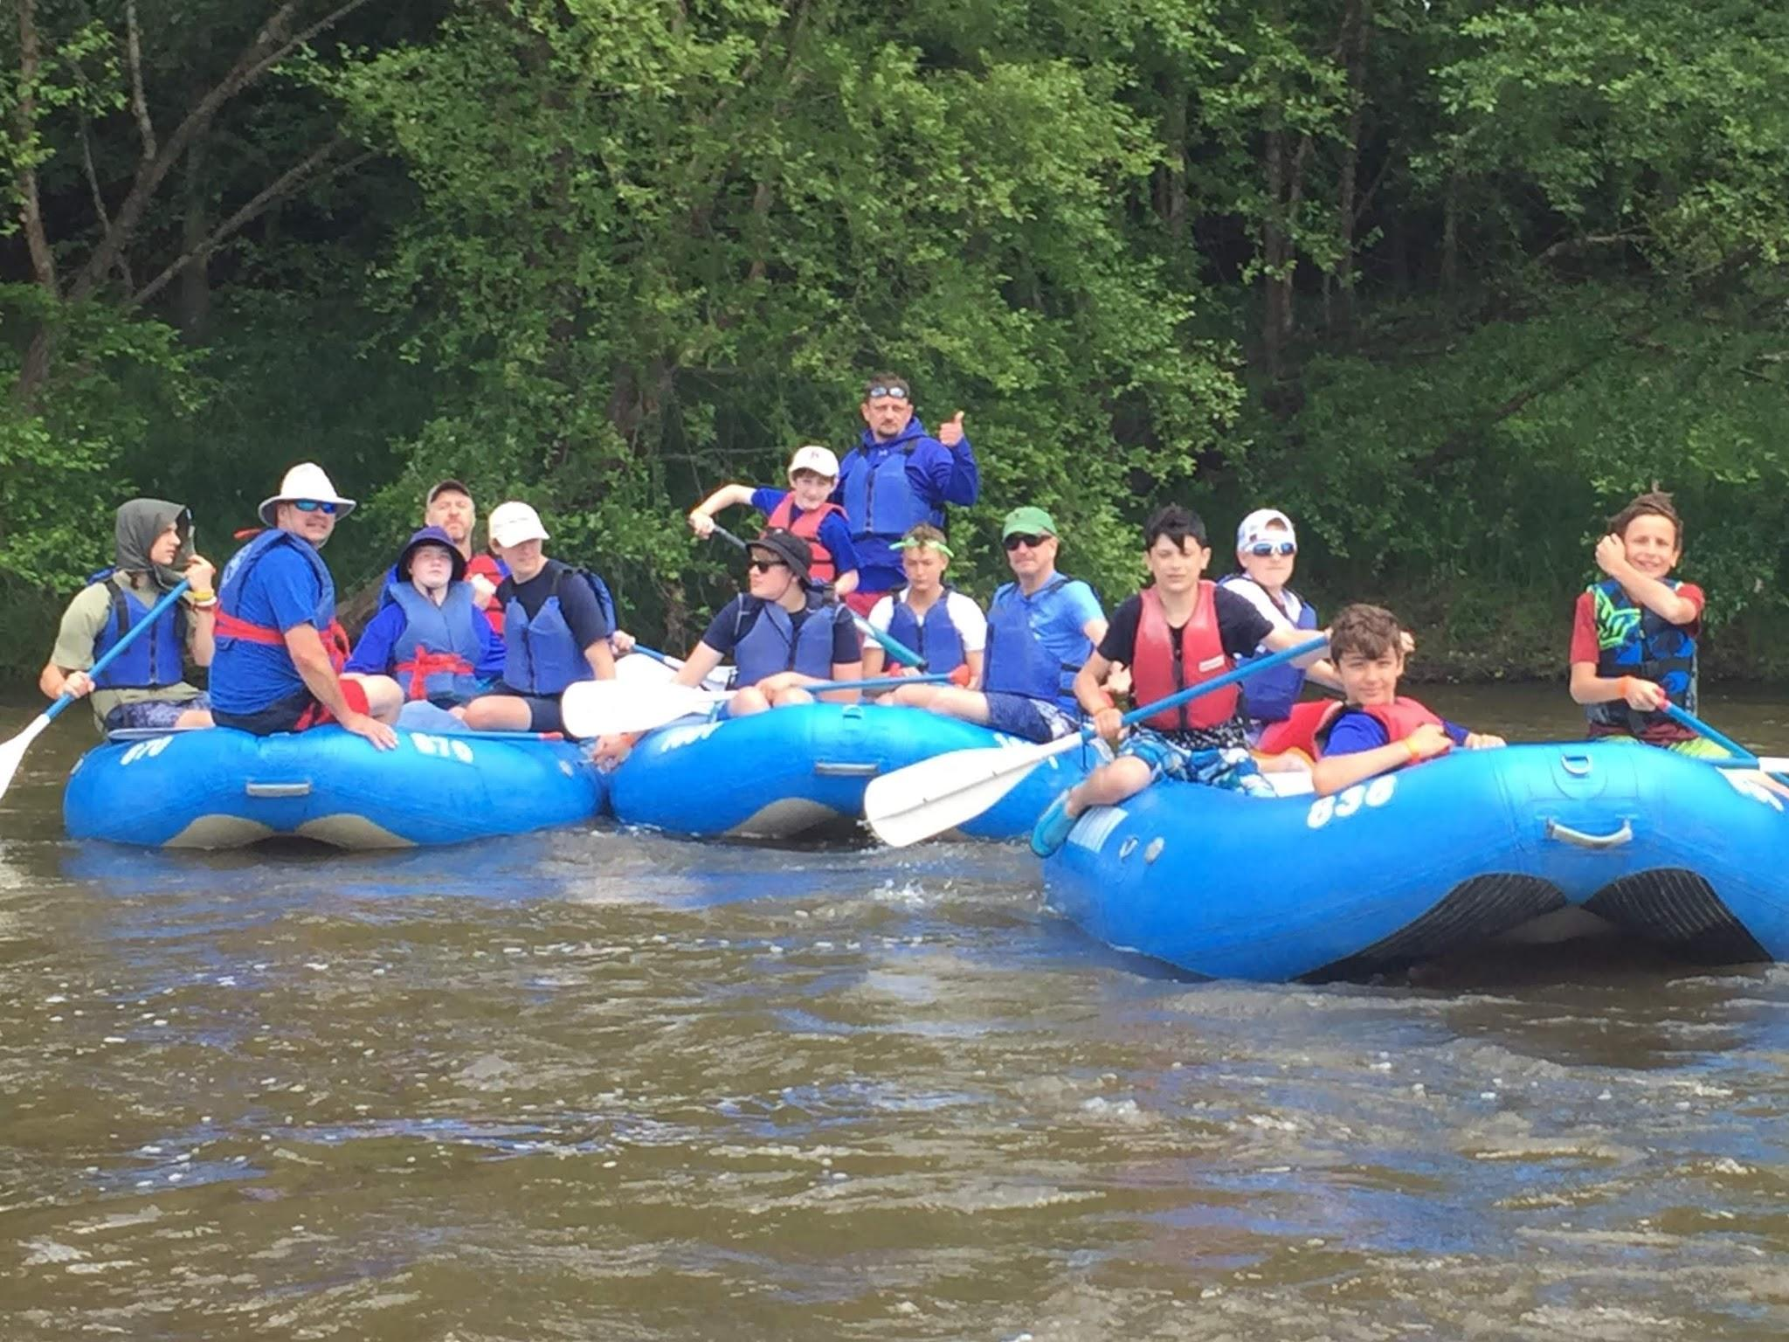
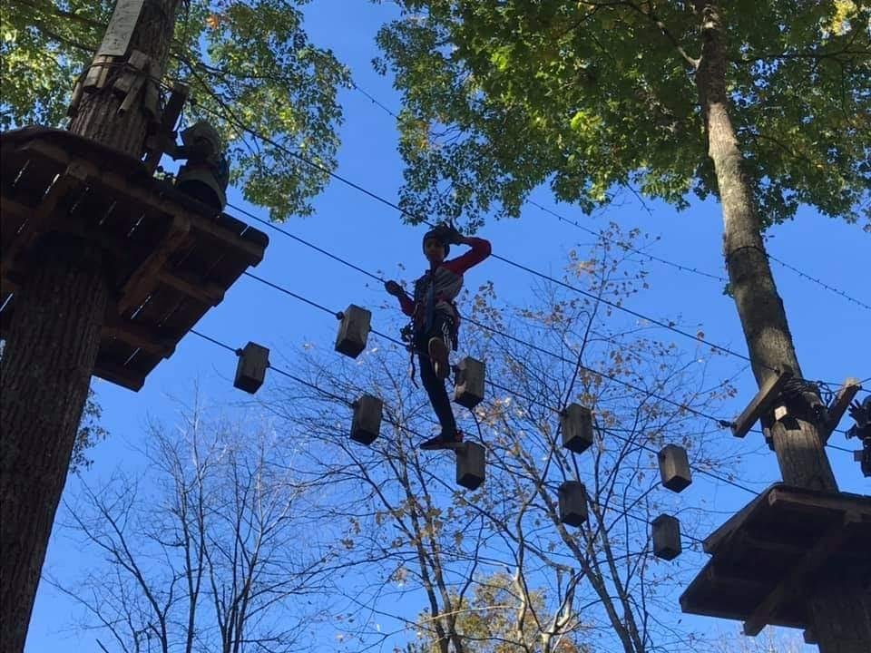
Campouts
Tent camping, lean-tos, backpacking
Skiing, canoeing, rock-climbing
One big campout
per year in June
See Troop Website
Fire
Knives
All the good stuff...
Martin

Slide 12
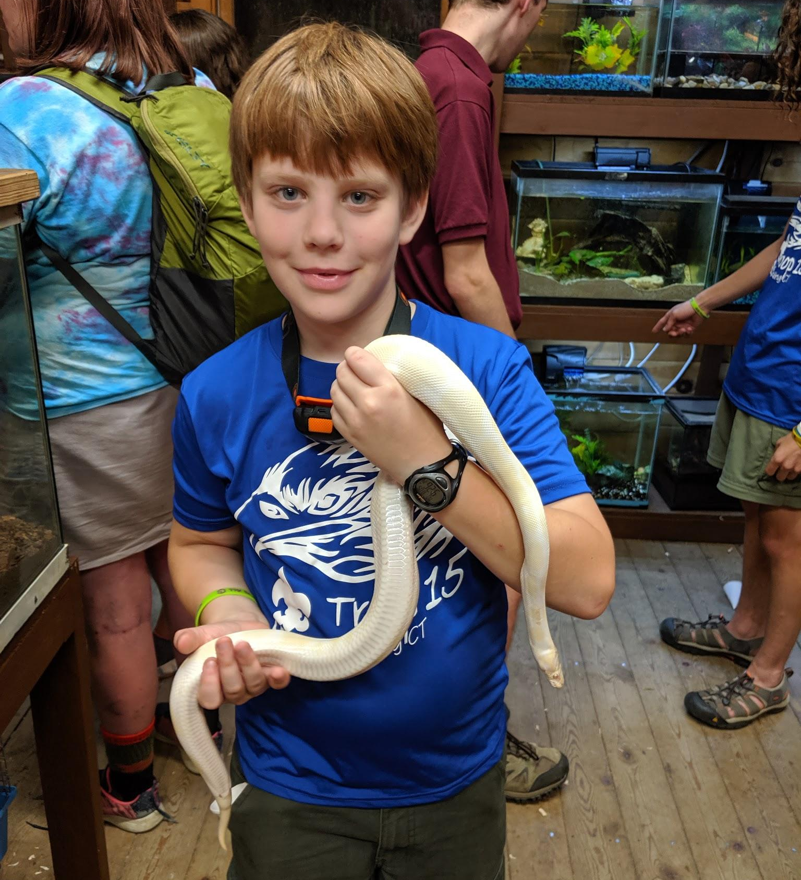
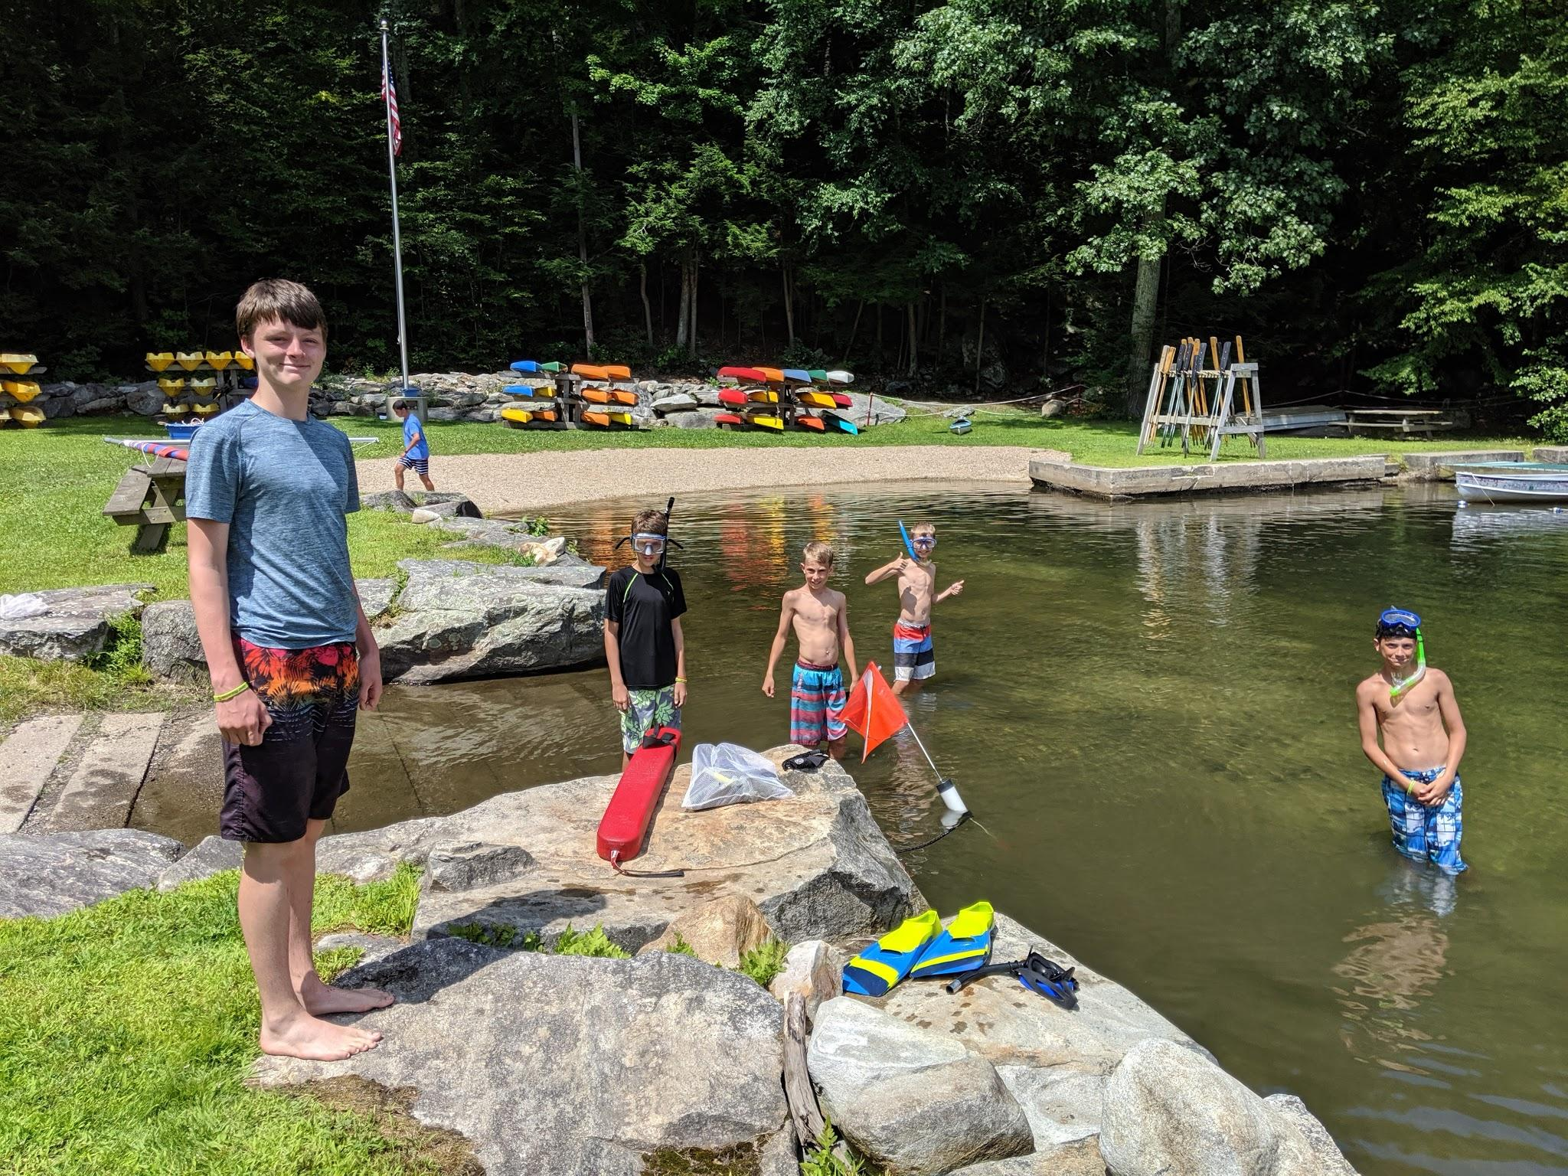
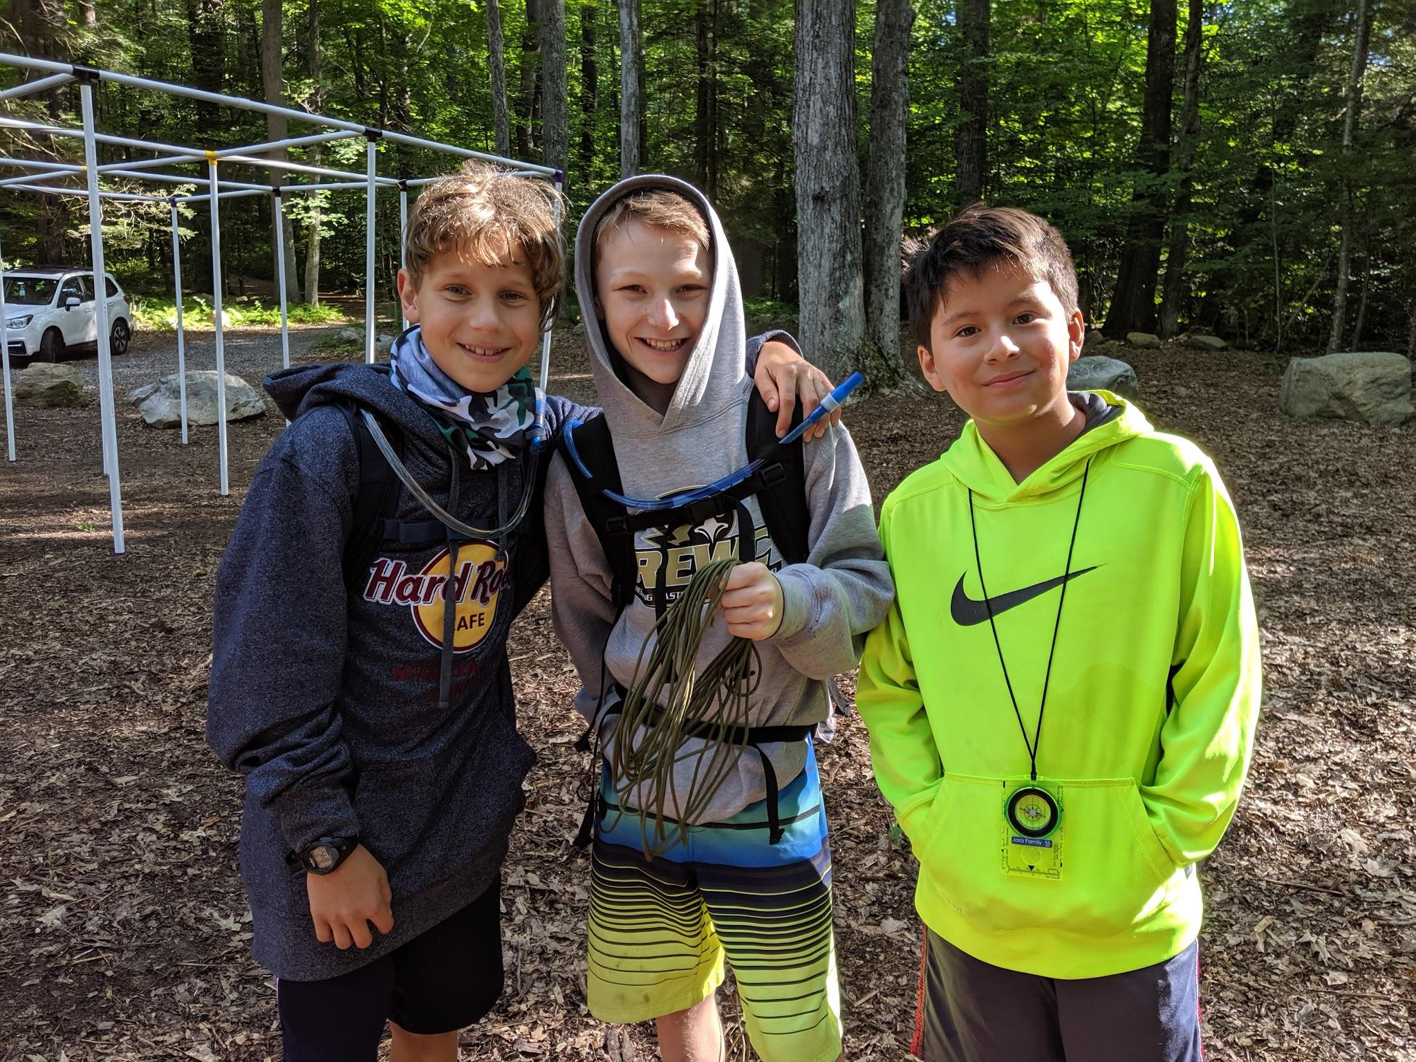
Summer Camp
One week sleepaway camp
Full of scouty goodness!
Shooting sports,
water front, campfires,
BMX biking, rock wall,
smelting iron, crafts,
mini zoo, star gazing,
sports, and more...
Martin

Slide 13
New Scouts Go Have Fun!
Jacob

Slide 14
Aims and Methods
of Scouting
What’s the point?
Jacob

Slide 15
Aims
Character development
Citizenship training
Mental and Physical Fitness
Jacob

Slide 16
Methods
Patrol Method
Advancement
Uniform
Leadership Development
Scouting Ideals
Outdoors
Adult Association
Personal Growth
Ed

Slide 17
Ten Essentials of a
New Scout Parent
How do I help my scout?
Jacob

Slide 18
Ten Essentials
Lead from Behind
Failure Is an Option
Ranking Up Is Not a Race
Chaos Is Normal...and Important
Don’t Do Dunkin’ Donuts
Avoid Pack Rat Syndrome
Safety First - Take Youth Protection
Encourage Your Child to Be a Scout...Not Just an Eagle Scout
More Than Mac N’ Cheese
Label EVERYTHING
Jacob and Nadya

Slide 19
Troop Policies and Procedures
The fine print...
Jacob

Slide 20
Requirement Sign-off
Only trained Scoutmasters and Assistant Scoutmasters can sign off requirements in Scout Handbooks
Scout Handbook is the ultimate record
Ed

Slide 21
Confidentiality
Procedures in place to keep personal information secure
All youth have different challenges: developmental, financial, social, etc.
Mainly only Committee Chair and Scoutmaster
No additional sharing unless discussed with parents
Jacob

Slide 22
Communications
Scoutbook and Email
  Set up your scout account once they are in Scoutbook!
  Make sure to set up a Scoutbook account for both parents
Weekly Announcements
Website ~ www.???.org
Calendar
Facebook ~ ???
Jacob

Slide 23
Scout Camp
Biggest event of the year!
Opportunity to bond with the new patrol
Finish Tenderfoot requirements
Special New Scout Training - Fire Safety and Bladed Tools
Scouts that attend Summer Camp are twice as likely to stay in Scouting
July 24-30, 2024??
Early bird - $470 (average cost of CT private summer camp is $1,200) / week
Kristen

Slide 24
FUNdraiser
The engine of the troop
Fundraising team rep.

Slide 25
Video
Nadya

