Slide 1
Introduction to
Cub Scouts
Pack (num) (Town) CT
(Month) 2023

Slide 2
What do we do in
Cub Scouts?
Job one is have fun

Slide 3
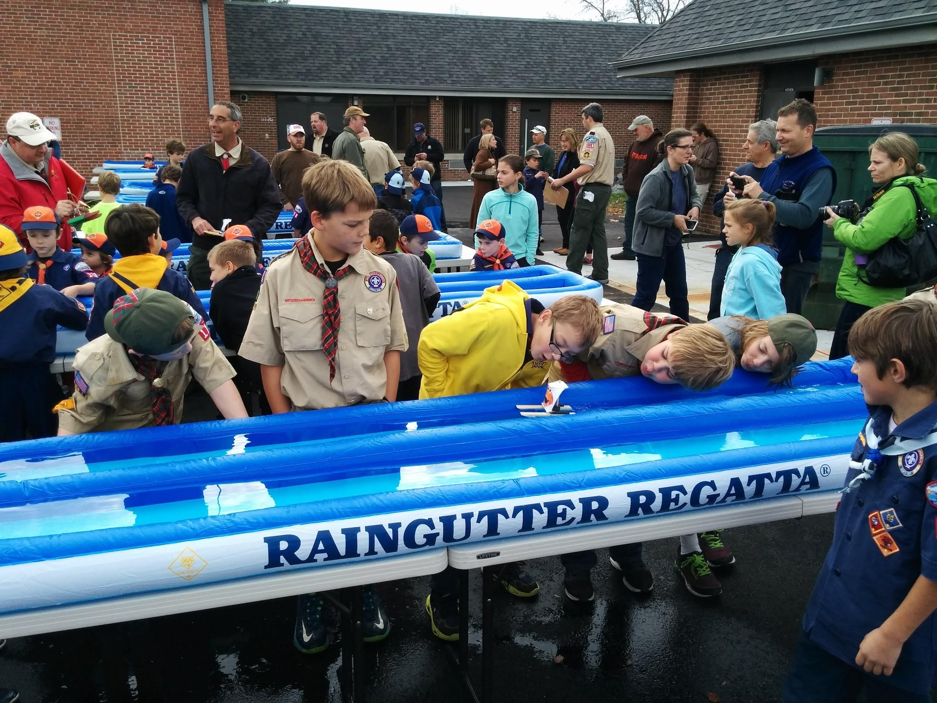
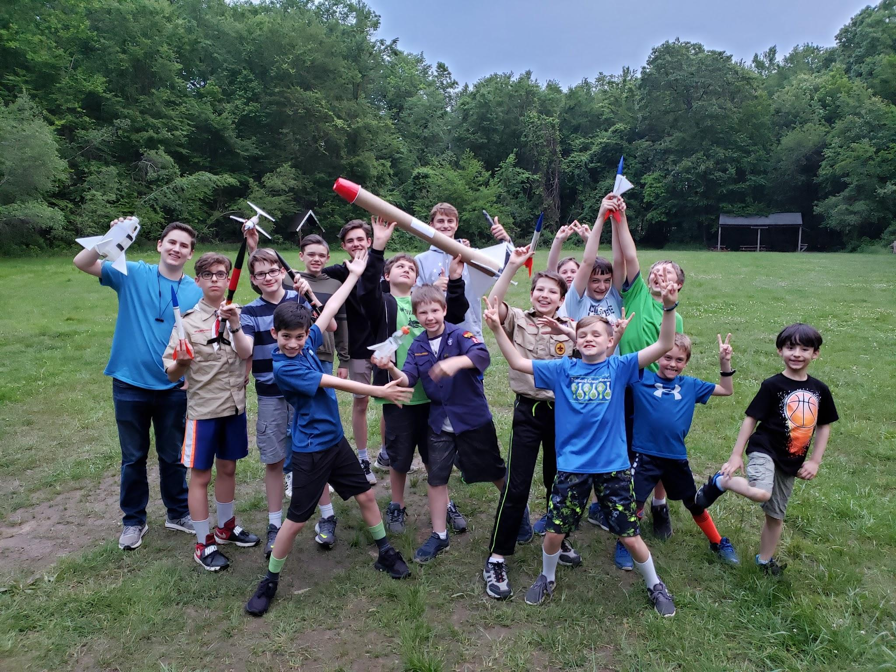
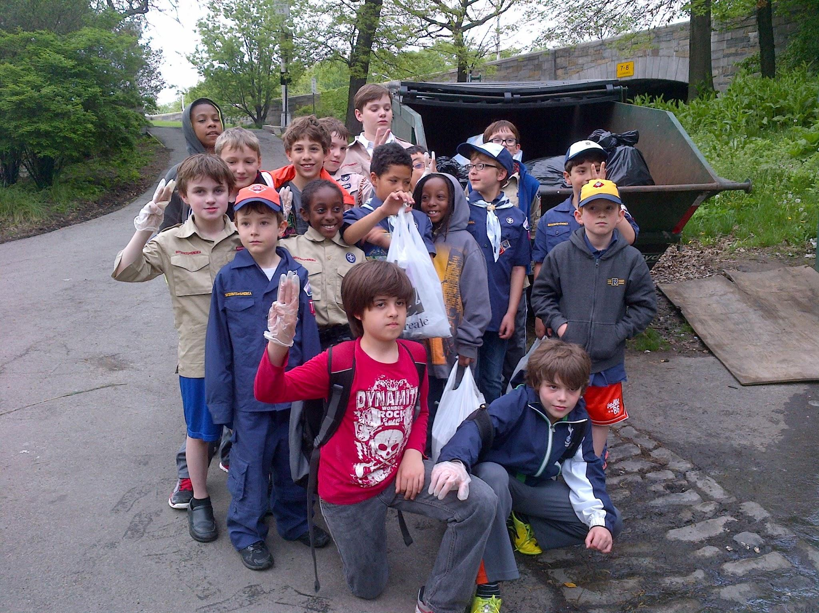
Pack and Den Meetings
Fun! Fun! Fun!
Hands-on learning
Outdoor fun
Service
Games
Challenges
3x per month during
school year

Slide 4
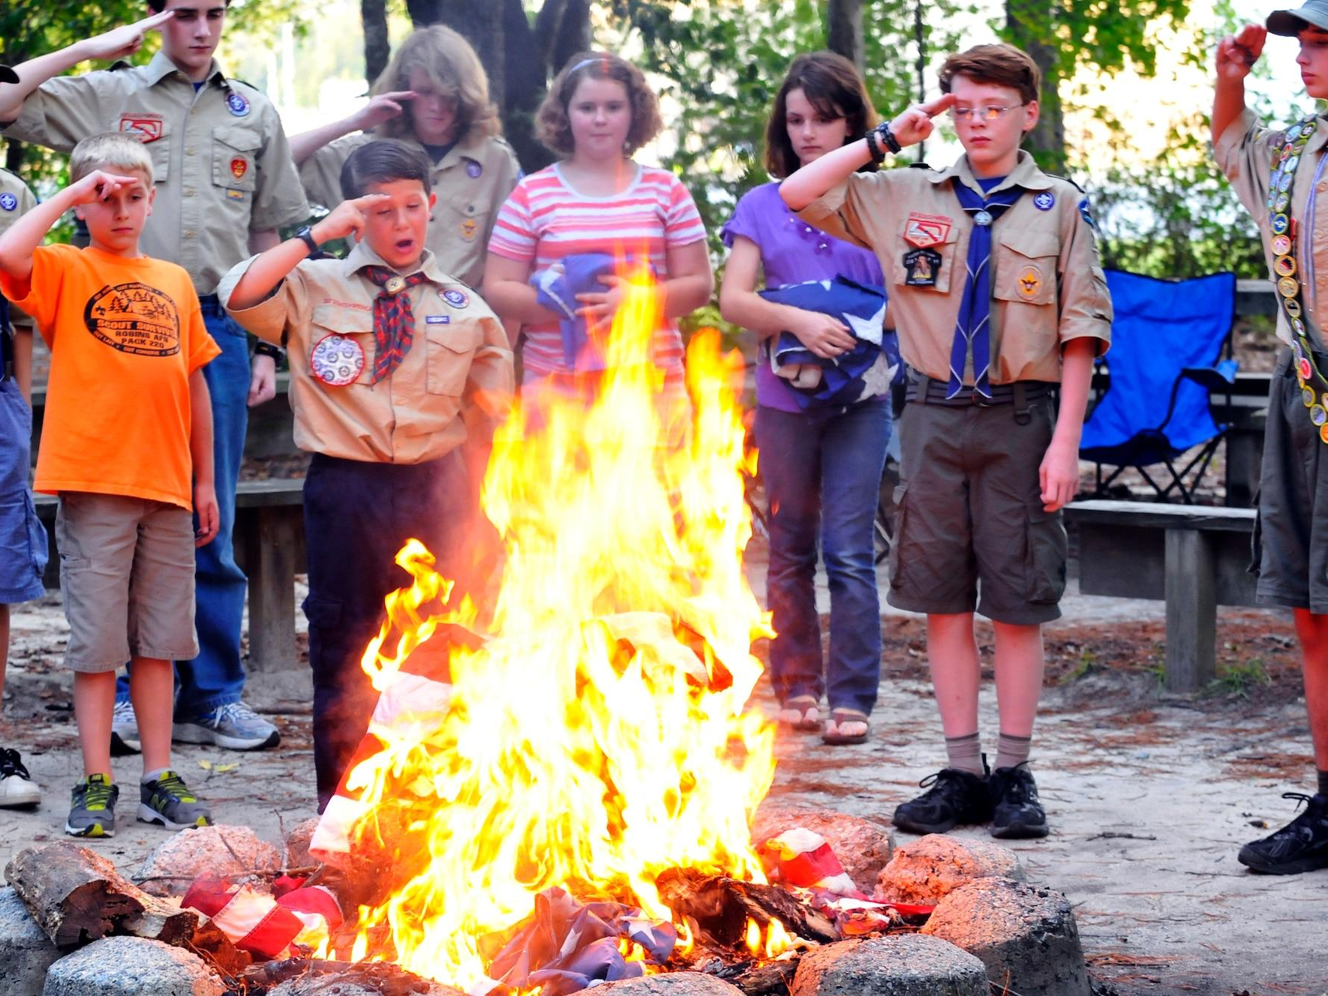
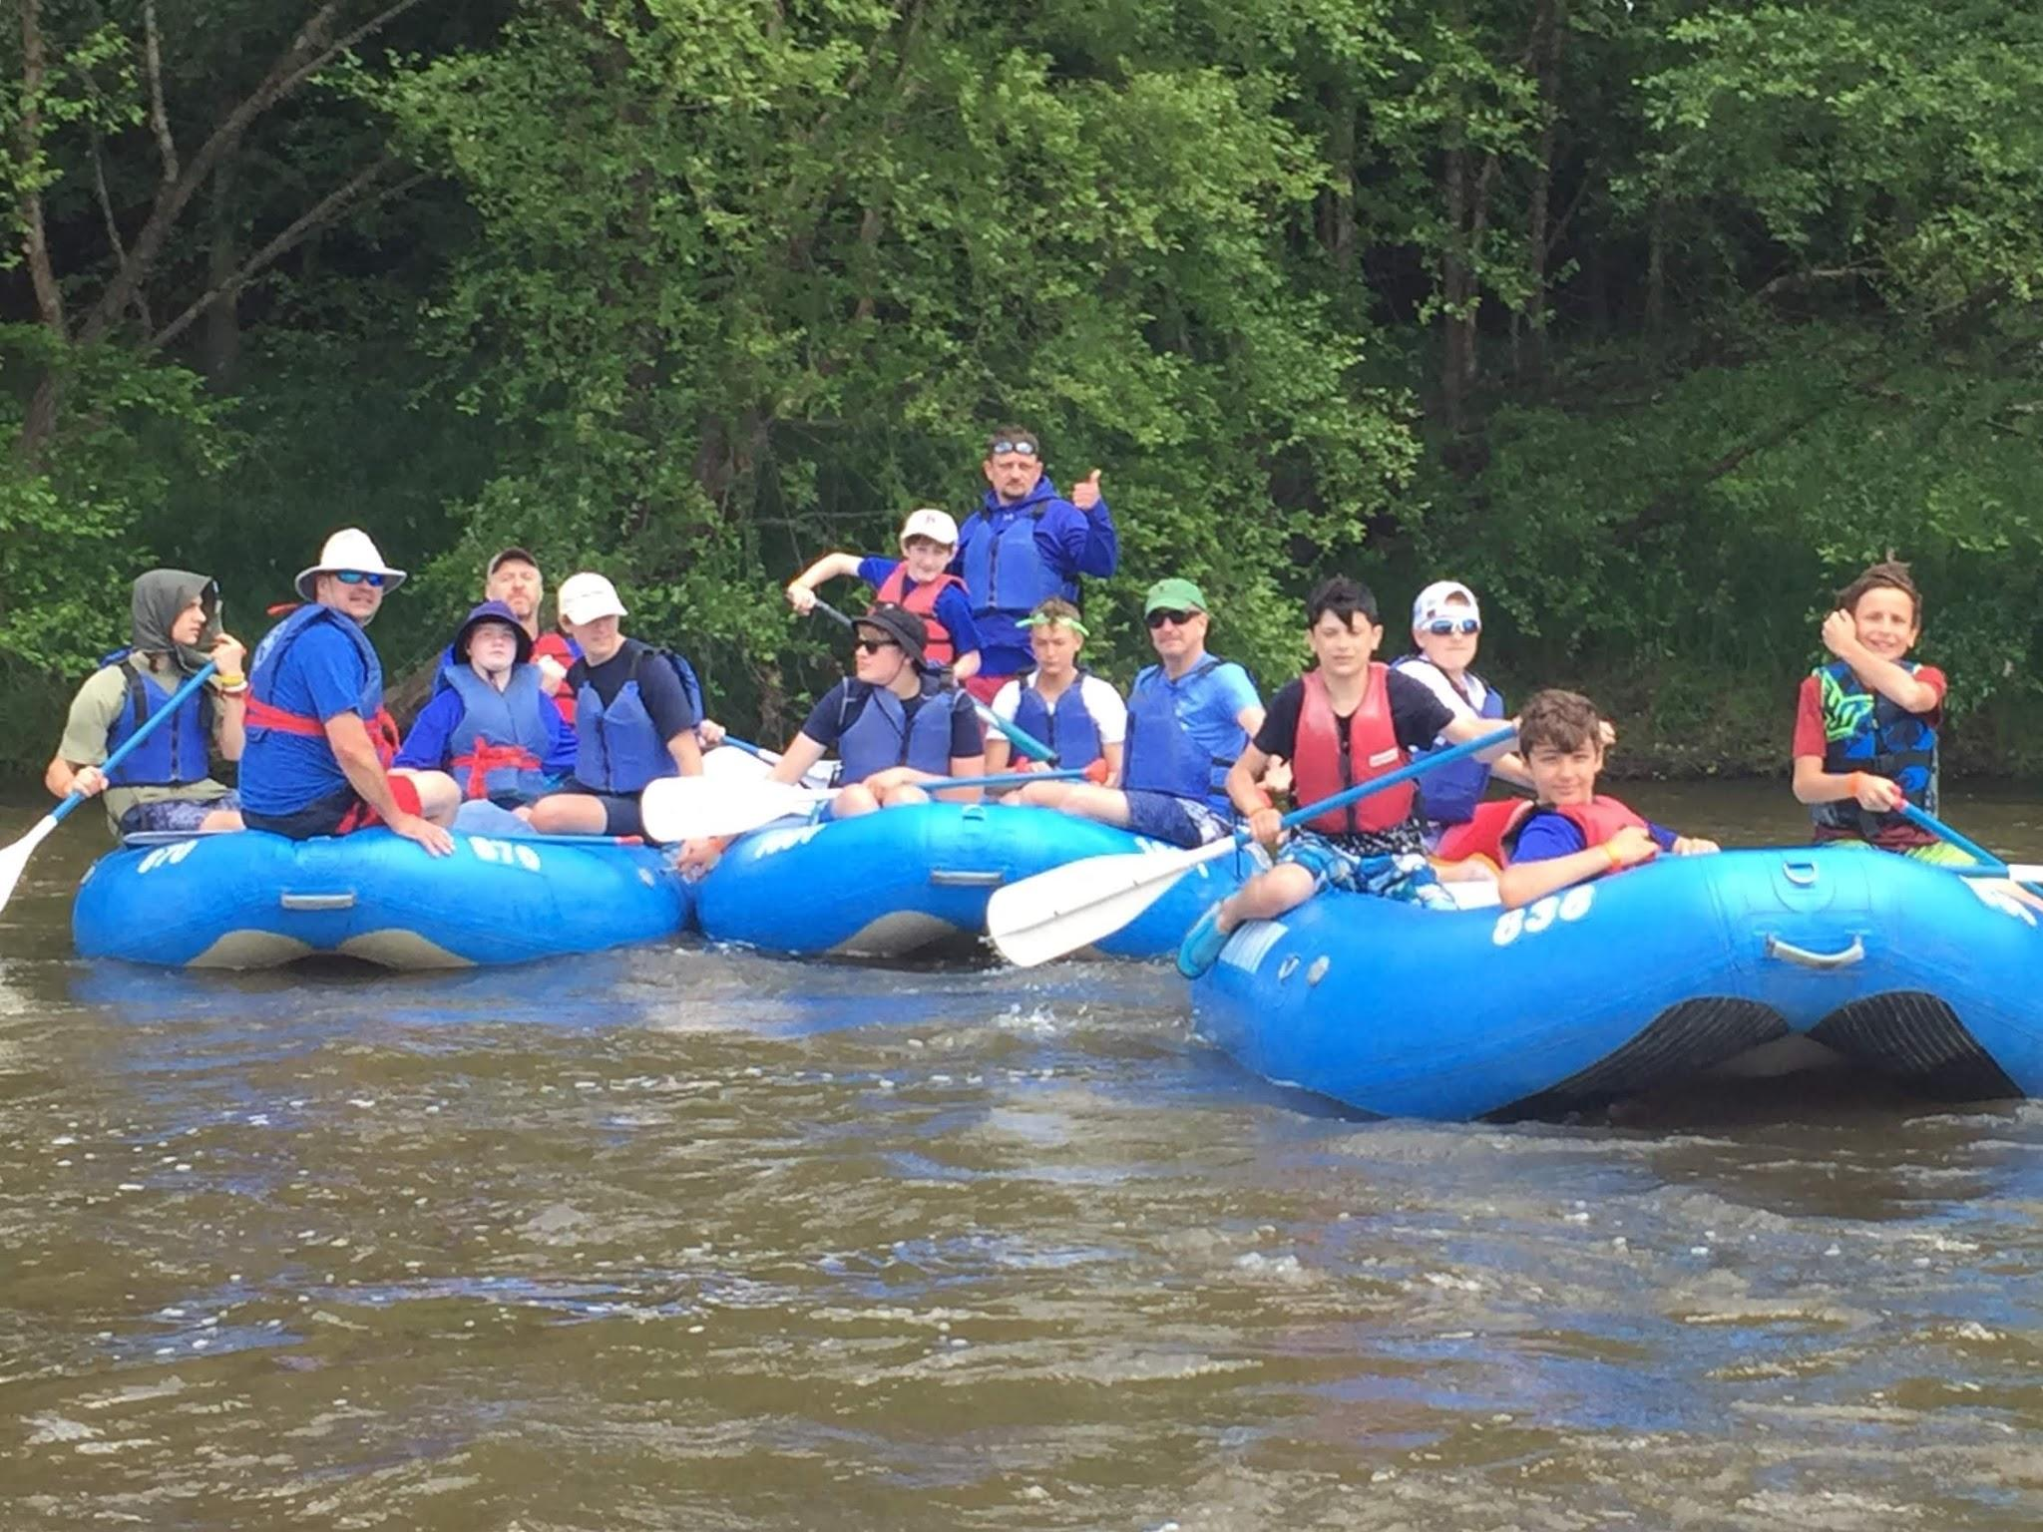
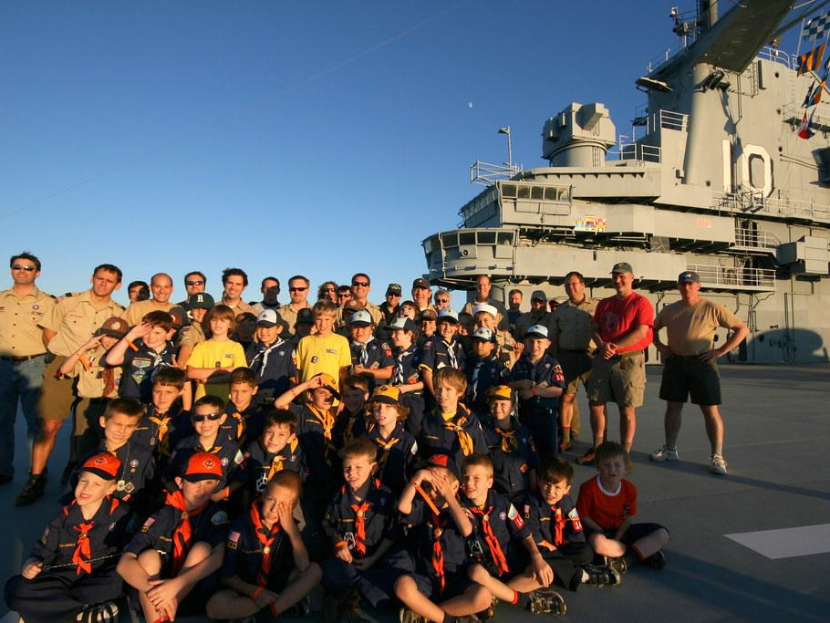
Campouts
Tent camping and Overnighters
Learning about nature
Conservationism
Water sports
Hiking
Outdoor together
For whole family
Appreciate nature
1 or 2x per year

Slide 5
How do we do it?
The engine of the pack

Slide 6
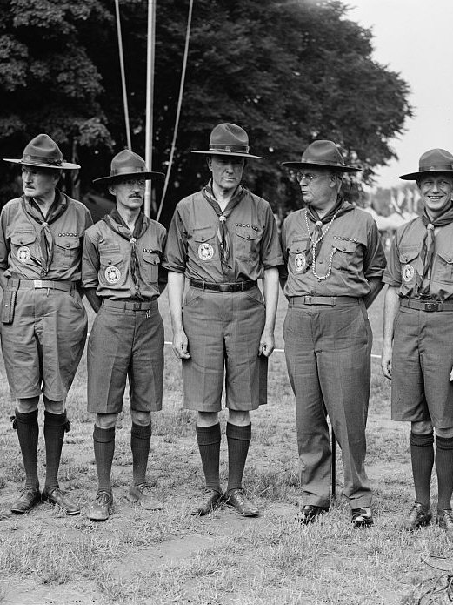
Pack Leadership and Org
Packs are led by adult volunteers
Not a “drop-off” program
Opportunity to share experiences
Kids are split up by grade, called Dens
Each Den has a Den Leader
Den Leaders use handbook for planning Den Meetings
Dens work toward rank every year
Cubmaster plans big Pack Meetings
Monthly Committee Meeting

Slide 7
Methods
Patrol Method
Advancement
Uniform
Leadership Development
Scouting Ideals
Outdoors
Adult Association
Personal Growth

Slide 8
Safety
Our #1 Job

Slide 9
Safety
Primary responsibility is safety
Youth Protection
  No one-on-contact
  Two deep Leadership
Certified trained leaders for all activities

Slide 10
FUNdraiser
The engine of the troop

Slide 11
Why do we do it?
What’s the point?

Slide 12
Aims
Character development
Citizenship training
Mental and Physical Fitness

Slide 13
Story

